Slide 1
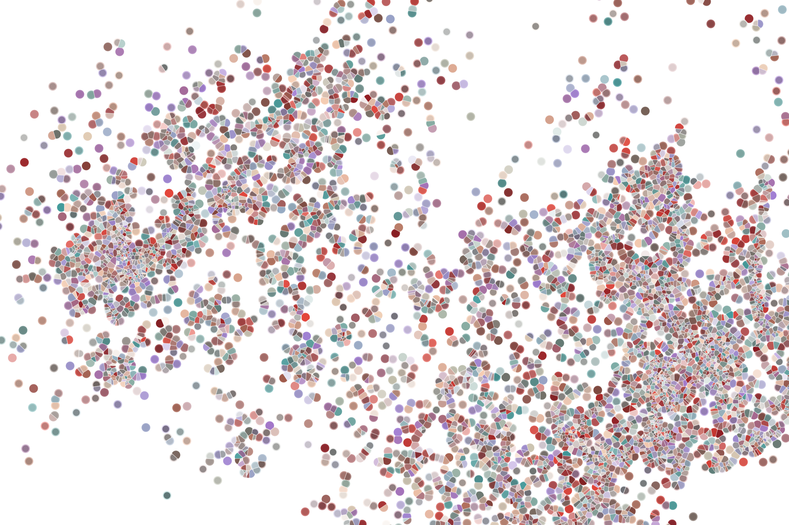
Other types of packages
Physalia course 2022
Instructor: Jacques Serizay
Notes:
Hello everybody and thank you for attending my presentation. I am going to talk about the project I recently started working on in the Spassky and Koszul labs, both located in Paris. This project focuses on the unusual cooption of the mitotic machinery to drive, not cell division but cell differentiation.

Slide 2
Incentivize other people to use your package
Your computer:
Many computers:
myPackage/
R/
functions.R
utils.R
man/
myfunction.Rd tests/
testthat.R
testthat/
test-myfun.R
inst/
extdata/
<raw-data-file>
data/
<data>.Rda
vignettes/
myPackage.Rmd
DESCRIPTION
NAMESPACE
README.md
NEWS
LICENSE
myPackage/
R/
functions.R
utils.R
man/
myfunction.Rd tests/
testthat.R
testthat/
test-myfun.R
inst/
extdata/
<raw-data-file>
data/
<data>.Rda
vignettes/
myPackage.Rmd
DESCRIPTION
NAMESPACE
README.md
NEWS
LICENSE

Slide 3
Incentivize other people to use your package
By providing high-quality public resources
By serving a polished documentation website for your package

Slide 4
Different types of public resources
http://bioconductor.org/help/course-materials/2014/summerx/Annotation-slides.pdf

Slide 5
AnnotationHub: retrieving release-specific files
The AnnotationHub package:
Provides a client interface to resources stored at the AnnotationHub web service.
Offers large-scale genome resources, lightly curated for easy access from R.
Supports tab-completion, metadata discovery, selection and filtering.

Slide 6
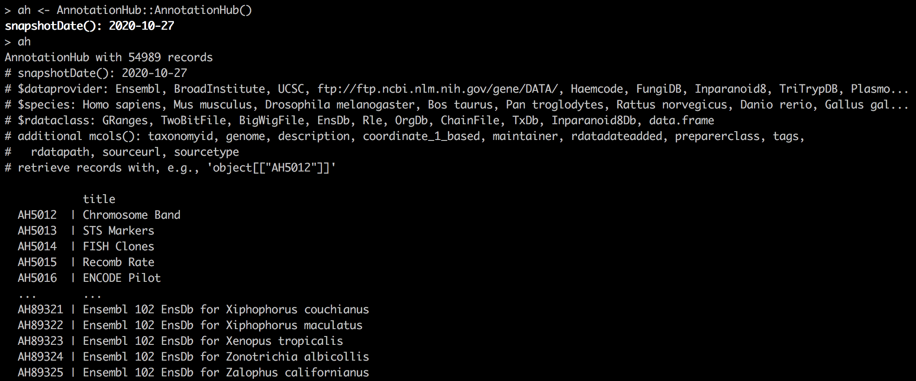
AnnotationHub: retrieving release-specific files
There are currently around 55K “records”, or files, available from the AnnotationHub.

Slide 7
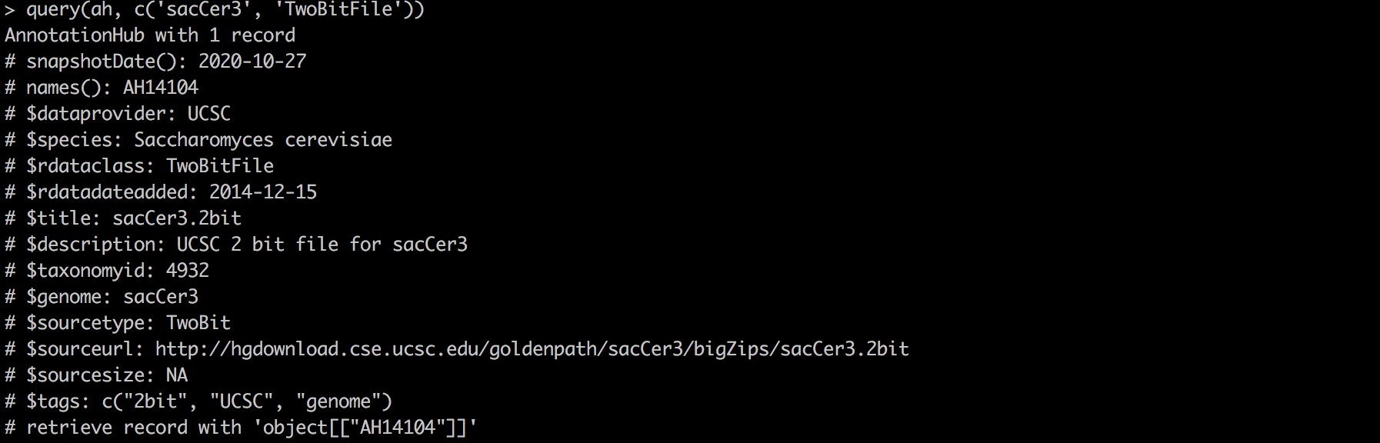
AnnotationHub: retrieving release-specific files
Queries are done using query(ah, “keyword”).

Slide 8
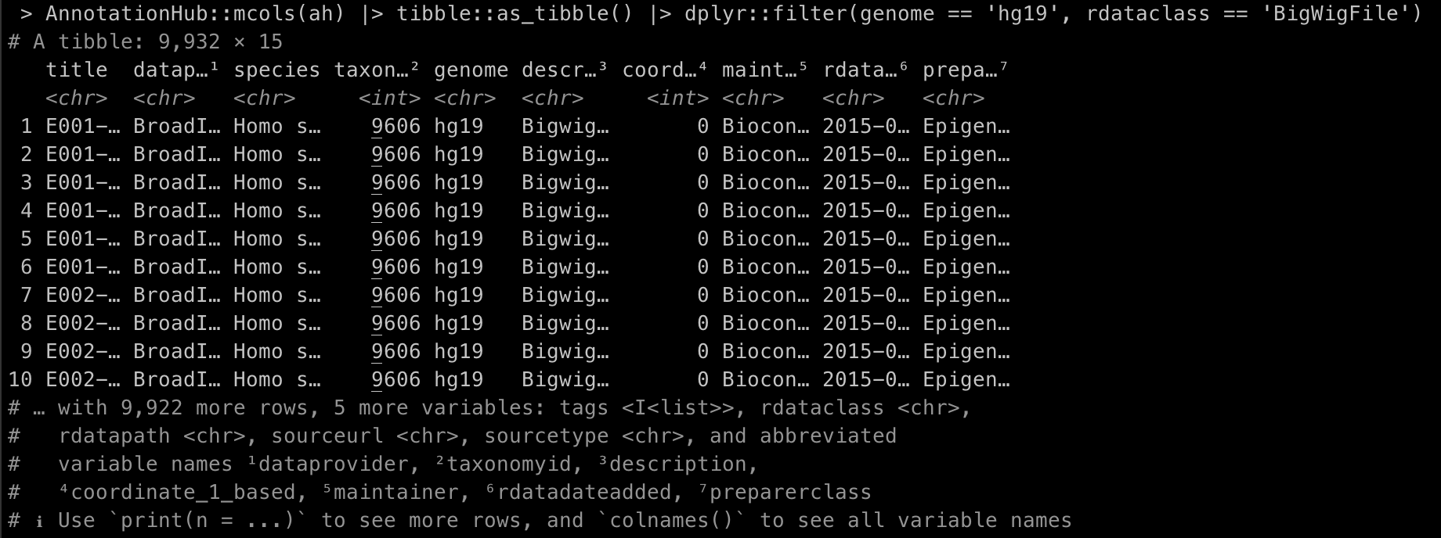
AnnotationHub: retrieving release-specific files
mcols(ah) can also parse the AnnotationHub as a data frame, for convenient filtering.

Slide 9
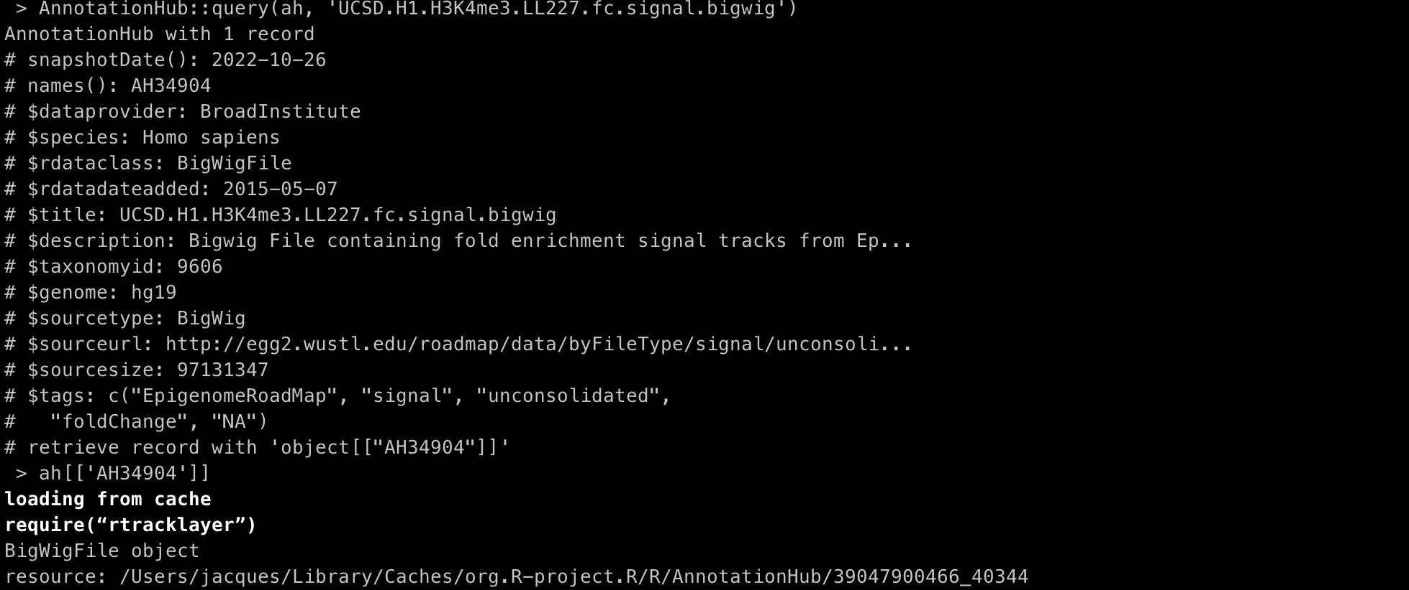
AnnotationHub: retrieving release-specific files
Objects (i.e. files) are retrieved using `[[`.

Slide 10
AnnotationHub: retrieving release-specific files
The files retrieved as stored on your computer!
Their location can be identified using `resource` function from the BiocIO package.

Slide 11
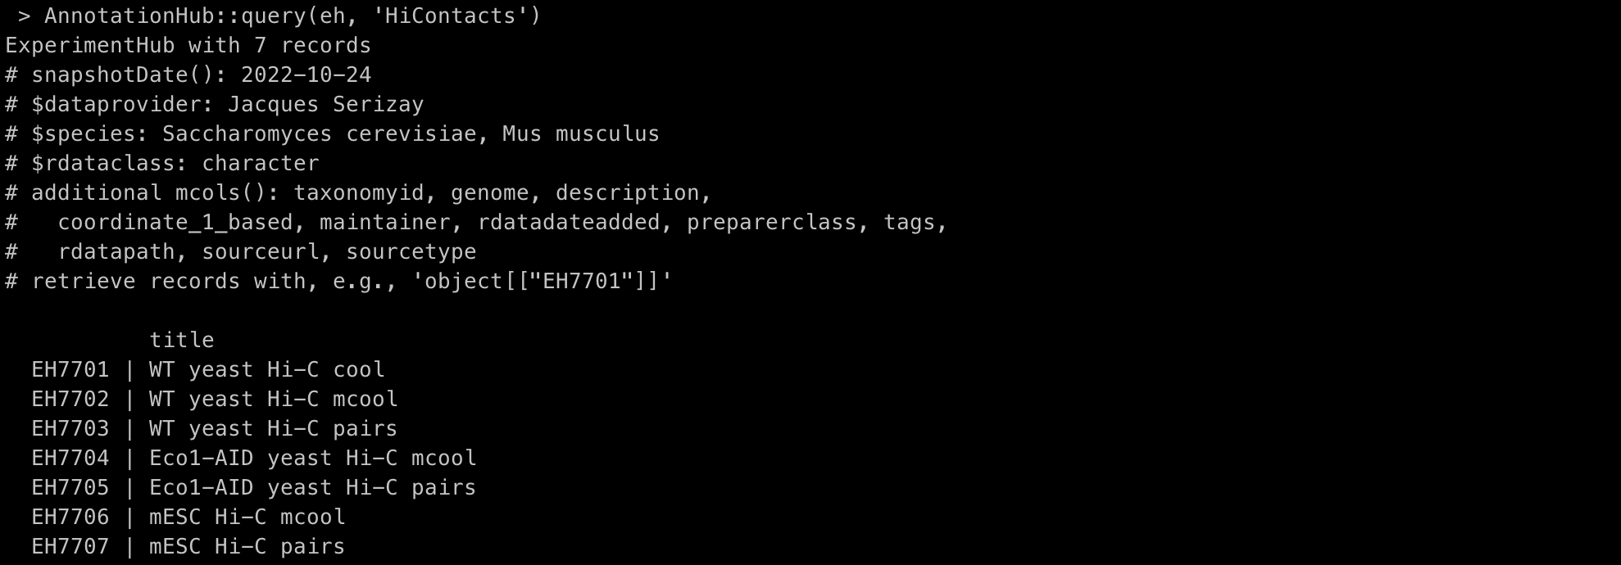
ExperimentHub: retrieving release-specific files
Same as AnnotationHub, but for actual experimental datasets.

Slide 12
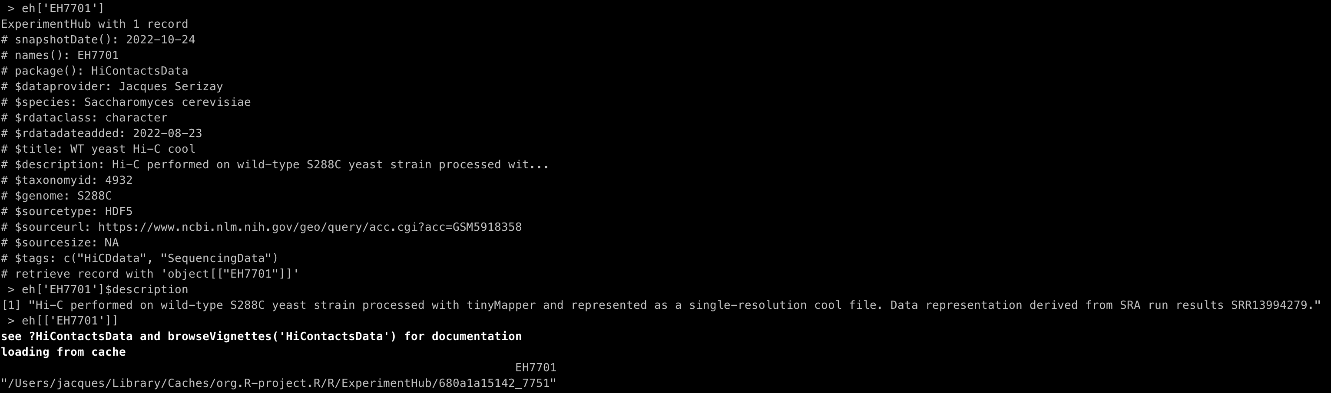
ExperimentHub: retrieving release-specific files
Same as AnnotationHub, but for actual experimental datasets.
Generally, the datasets are provided to help demonstrating the use of a package.

Slide 13
ExperimentData packages
Experiment data packages enable access to data sets that are used, often by software packages, to illustrate particular analyses.
These packages provide a gateway to curated data from an experiment, teaching course or publication.
The actual data will be managed by the ExperimentHub.

Slide 14
ExperimentData packages
Similar requirements as software packages.
Most importantly, proper documentation for the data included within the package is required.
Traditional Annotation and Experiment packages are not ideal.
AnnotationHub and ExperimentHub interfaces and packages are desirable.

Slide 15
Developing an experimentData package
The package should minimally contain:
The resource metadata
Man pages describing the resources
A vignette
It may also contain supporting R functions the author wants to provide

Slide 16
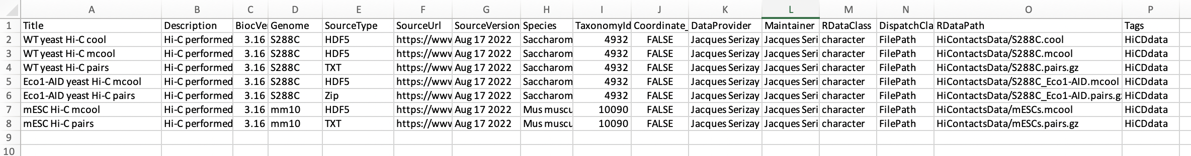
Resource metadata
Stored in inst/extdata/metadata.csv

Slide 17
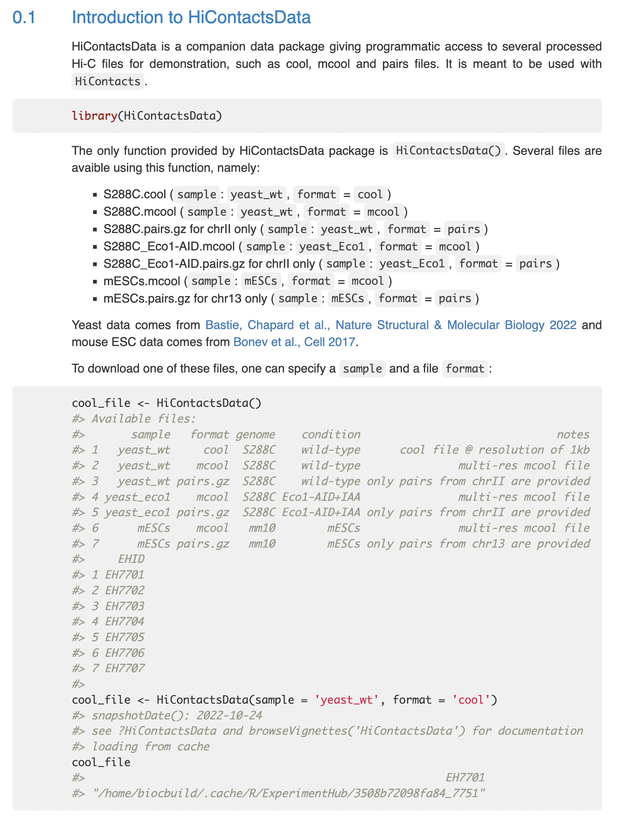
Vignette

Slide 18
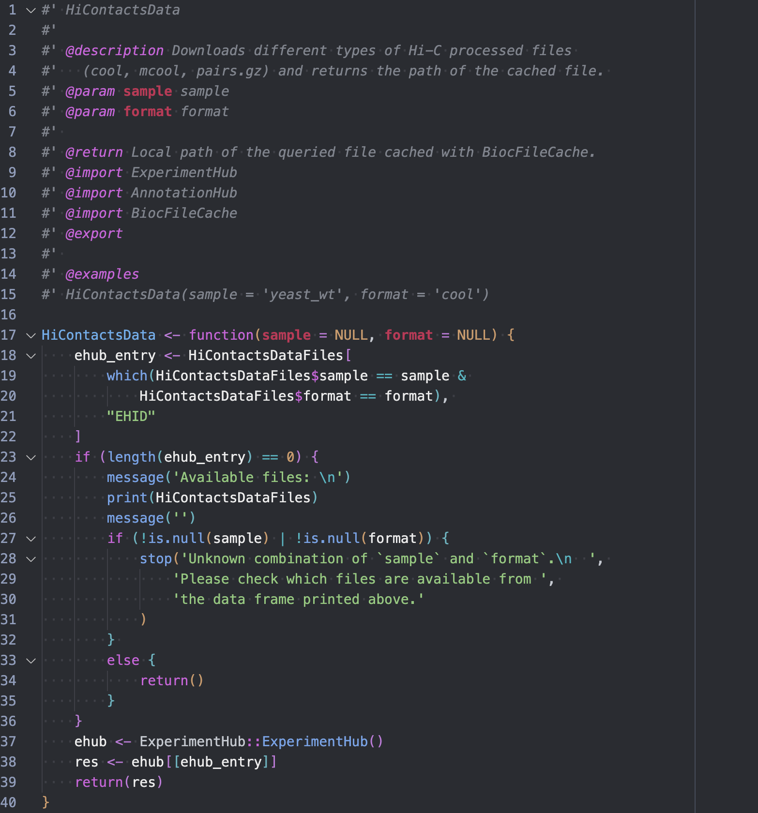
Accessory function

Slide 19
Developing an experimentData package
Open a submission issue for your ExperimentData package
Wait until a reviewer is assigned
Add your analysis package to the issue by commenting in the issue:
`AdditionalPackage: https://github.com/<yourGH>/<yourPackage>`
This ensures that the ExperimentData package is first available to Bioconductor submission building machines, so that the software package has access to it when submitted next to the same virtual machines.

